Slide 1
Four Things We Can Learn From Transactional Analysis
Ian Tomlinson

Slide 2
Who am I?
Curriculum Manager for Science at Lathom High School, Skelmersdale
Department received “Outstanding” in a subject specific inspection May 2011
Trained Curriculum Leaders for Science and Technology For The Teaching Leaders Government Programme
Trained and practicing psychotherapist and couples counsellor
Worked with Edge Hill University for a very long time! So seen many students.

Slide 3
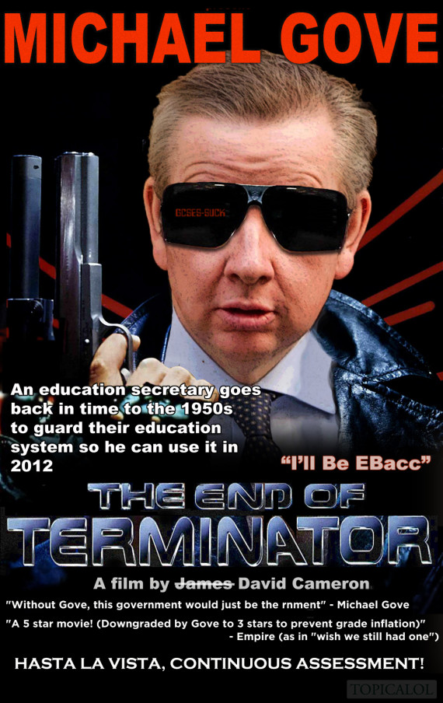
The Challenge …
Keeping our Humanity

Slide 4
Fundamentally
Teaching is about
relationships

Slide 5
“ …the most crucial and powerful learnings happen within the context of a positive and understanding relationship between teacher and learner.” (Temple, 1997)

Slide 6
Teachers are not just “technicians” delivering a predetermined curriculum.
If relationships are so important then it must be important to understand how human beings relate to each other.
Transactional Analysis is a good model to use to understand and develop relationships and interactions (transactions).

Slide 7
Basic principles of TA
“I’m OK, you’re OK”
Everyone can think
Everyone can change

Slide 8
Think about how this information applies to you too. This is about all of us, not just the children you teach.

Slide 9
The TA ideas I’ve chosen for you today are …
Psychological hungers
Strokes
Script
The 3 P,s

Slide 10
Psychological Hungers
Eric Berne (the creator of TA) stated that all human beings have three fundamental needs:
Stimulation
Structure (pattern and predictability)
Recognition

Slide 11
As teachers we can provide these
Stimulation – what we ask a student to do can be a key factor in how they behave. Easy, low demand tasks can lead to other sources of stimulation being sought, as can tasks that are too challenging.
Structure – Vitally important! The students crave this. Without it they will feel unsure and unsafe.
Recognition – stroke theory can help us understand this need.

Slide 12
You are important too!
How does structure keep you safe? Good lesson planning with clear sections to lessons can help you feel confident.
Recognition from tutors, mentors and students is important. Ask for it!

Slide 13
Strokes
Strokes are a “unit of recognition”
All human beings crave strokes. We want to feel “seen”.
Positive strokes are best but negative strokes are better than no strokes at all.
Strokes are one reason why solitary confinement in prison is the harshest punishment

Slide 14
Types of strokes
Positive Conditional “Your work is very good” | Positive Unconditional “I’m really pleased to see you”
Negative Conditional “I’m annoyed with how you are behaving in this lesson” | Negative Unconditional “You’re such an idiot”

Slide 15
How we can use this …
Give positive strokes and make sure you give unconditional strokes as well as conditional ones.
Give negative conditional strokes sparingly
At all costs avoid negative unconditional strokes – they have a huge impact and reinforce negative script beliefs.

Slide 16
“What you stroke is what you get”.

Slide 17
And for you …
Ask for strokes if you are not getting them. It’s OK to ask for what you want!
Notice the things you are doing well (self stroking is OK).
If there are things not going well realise that the feedback you are getting is not about your worth as a human being but about how you performed in one particular lesson.

Slide 18
Script
During early years a child will form conclusions about himself, others and life.
These conclusions form the basis of self concept and self esteem later in life
Sometimes the messages received are negative or there may be a lack of positive
In these cases the child looks for ways to ensure they get strokes by constructing a “script”
These script messages are instructions on what to do to survive

Slide 19
The “don’t” script messages
Don’t succeed | Don’t Grow Up
Don’t Feel (express feelings) | Don’t Be You (Don’t Be The Sex You Are)
Don’t Be Important | Don’t Do Anything (nothing you do is right)
Don’t Belong (Don’t Be Close) | Don’t Exist (you are the cause of all our misfortunes)
Don’t Be A Child | (Goulding and Goulding)

Slide 20
What we can do as teachers …
Provide a positive environment where the “don’t” messages can be challenged.
Be aware that students may need to be gently encouraged to see that the messages are false.
Realise that bad behaviour is nothing personal.

Slide 21
‘Children do not behave in a challenging way to be a problem, but as a solution to the problem’
(Hemmings, 2003)

Slide 22
For you …
Notice which “don’t” messages you carry around with you. Challenging them may bring up feelings for you but nobody ever died from having feelings.
If you are struggling get help. It may be from your tutor, mentor or friend. If your script is really getting in the way then you might want to seek out a therapist.

Slide 23
The 3 P’s needed to counteract script …
Permission
Protection
Potency

Slide 24
Permission
To go against script beliefs. Eg. Permission to challenge the “don’t think” script belief by coming up with their own answers in lessons (not having it reinforced by teacher giving the answers easily).

Slide 25
Protection
The creation of an environment where a child feels safe.

Slide 26
Potency
Giving the inspiration and empowerment to support growth and to help the students stand up for themselves.
You are “in charge” and you know what you are doing!

Slide 27
Notable things I’ve left out …
Ego states
Transactional Analysis Proper
Life Positions
Passivity
Time structuring and Game theory

Slide 28
Want to learn more?
Find these slides on iantomlinson.co.uk
Manchesterpsychotherapy.co.uk for more information on TA
iant241@gmail.com
Best book: TA Today – Stewart and Joines

